Slide 1

Control Board use for LATM
Apicha Panoram
March 2024

Slide 2
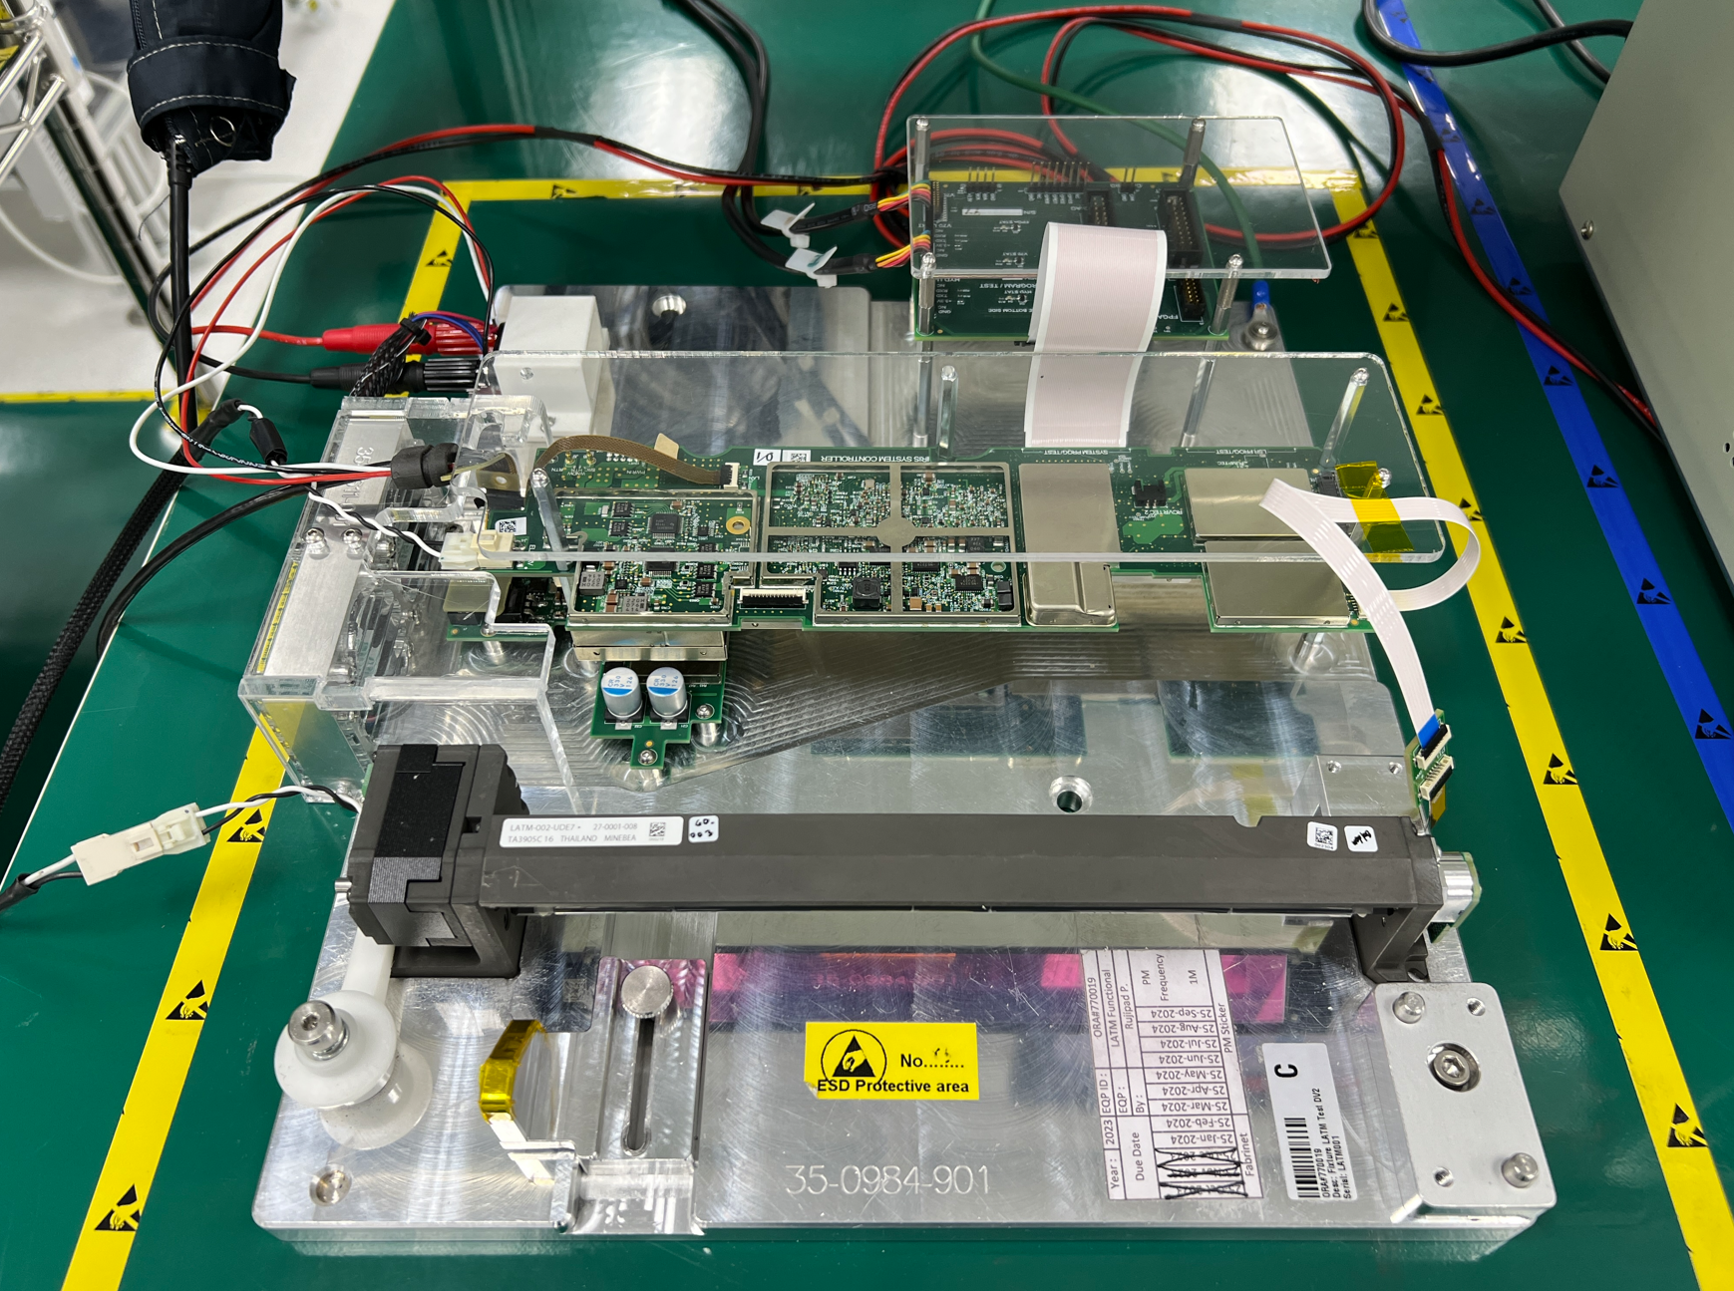
Controller Board – Manual Test Station at Fabrinet Chonburi
To PC’s USB ports
Prog Test Board
J6 V70 UART
51-conductor flex cable
Power Input Cable 12V
Power Supply 12V
J7 HYDRA UART
+
-
Controller Board
position-sensor flex cable
J4 EL DRV
EL Motor interposer cable
position sensor adapter interposer circuit board
J5 EL SNS
LATM Assy
LATM Test Fixture

Slide 3
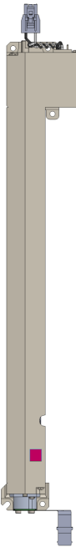
Controller Board – Manual Test Station Diagram
Monitor
AC Power
Keyboard
Mouse
DC Power
USB Cable
USB Port
USB Port
Display Port Cable
Facility Power
Computer
Position-sensor flex cable
51-conductor flex cable
USB Port
EL Motor interposer cable
USB Port
USB Port
Prog Test Board
J6 V70 UART
J7 HYDRA UART
SYSTEM PROG/TEST
USB Port
Controller Board
Power Supply
12V 3A
+12V
J4 EL DRV
J5 EL SNS
Position sensor adapter interposer circuit board

Slide 4
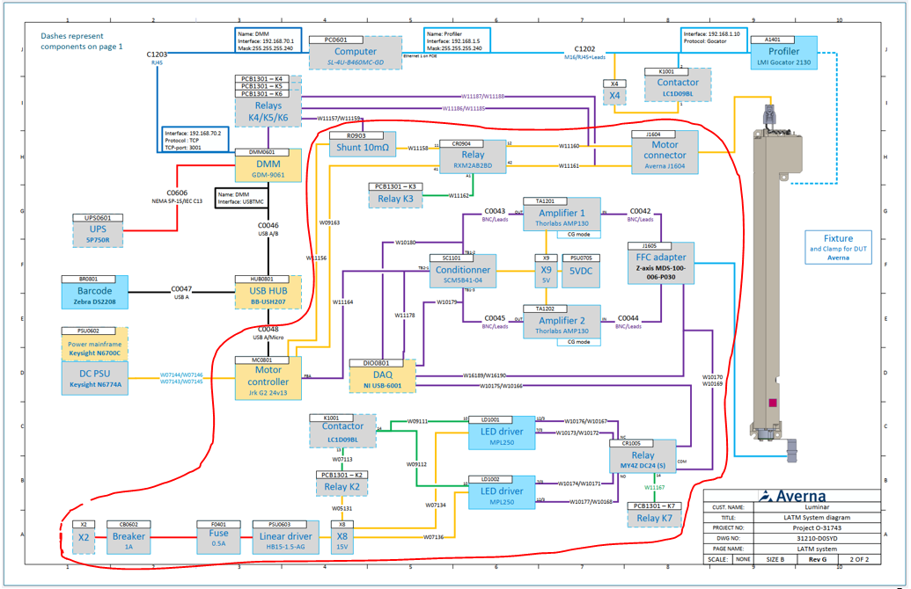
Jrk Controller – Averna LATM Test Station
Remove this red frame and replace with LATM Controller Board

Slide 5
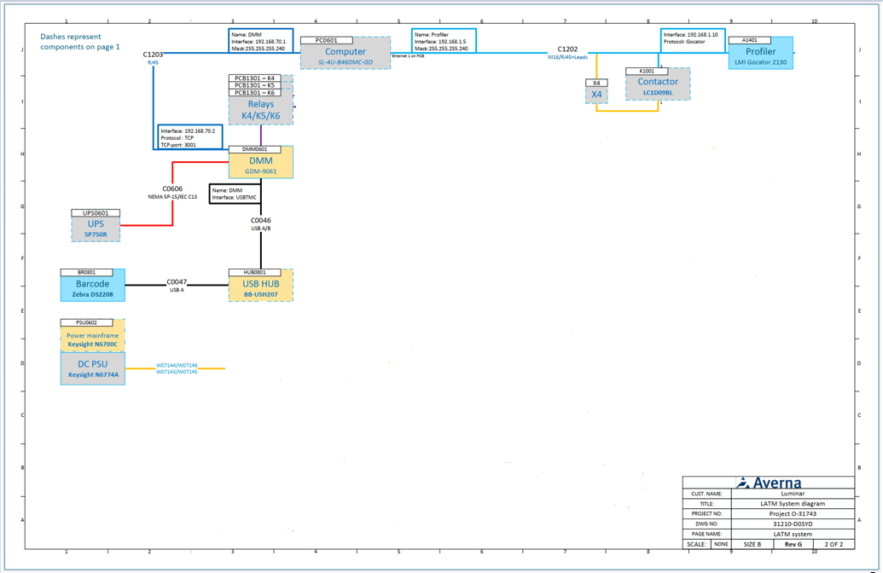
Controller Board at Averna Test Station
USB Cable
Prog Test Board
J6 V70 UART
USB Cable
J7 HYDRA UART
51-conductor flex cable
SYSTEM PROG/TEST
Controller Board
+12V
J4 EL DRV
J5 EL SNS
Position-sensor flex cable
EL Motor interposer cable
Position sensor adapter interposer circuit board

Slide 6
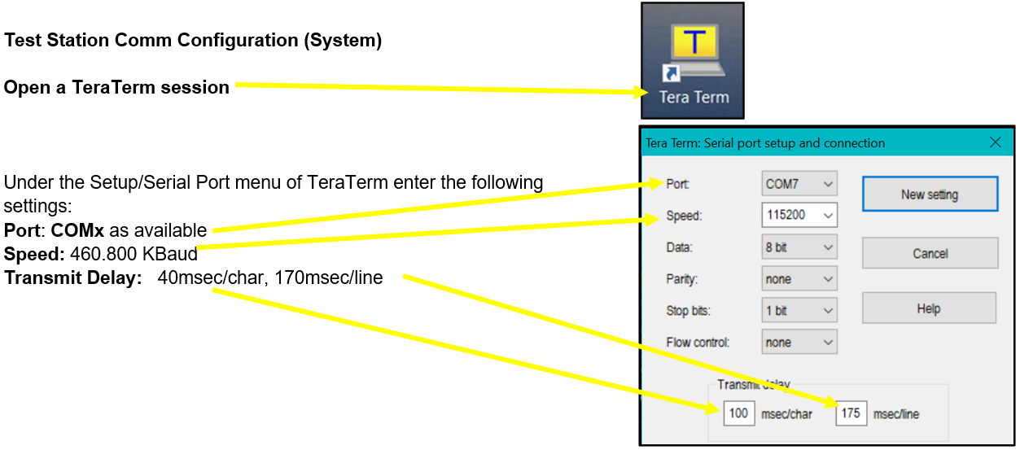

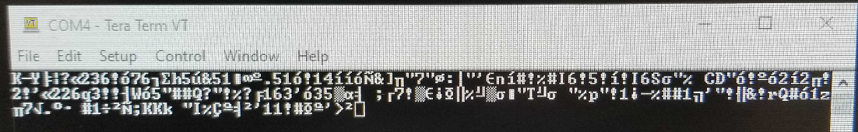
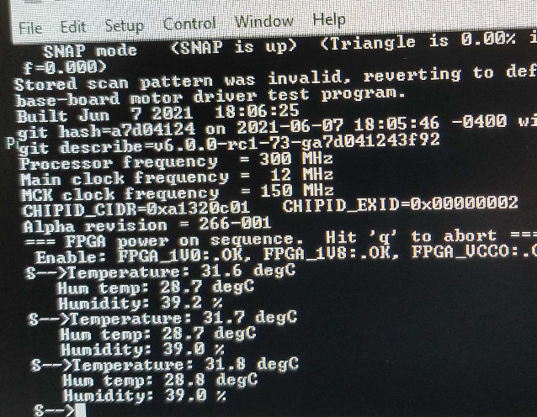
1) Turn on the power supply and set the Tera Term for Comm Config. System
1.1 Setup/Serial Port menu of Tera Term
USB Cable
Computer
Prog Test Board
J6 V70 UART
USB Port (Serial Com Port)
J7 HYDRA UART
USB Cable
USB Port (Serial Com Port)
1.2 Check TeraTerm display
51-conductor flex cable
SYSTEM PROG/TEST
Power Supply
12V 3A
+12V 0.61A
Controller Board
+
-
J4 EL DRV
J5 EL SNS
1.3 Verify text is legible to read, and prompt is “S -->” (System)
EL Motor interposer cable
Position-sensor flex cable
Position sensor adapter interposer circuit board

Slide 7
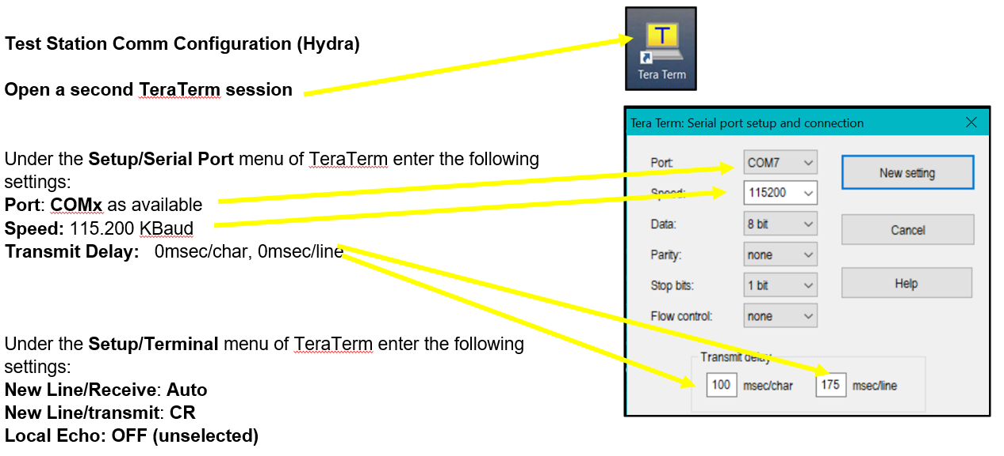
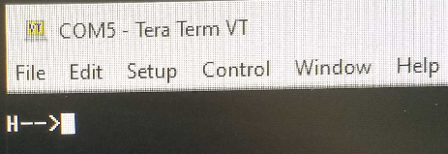
2) Set the Tera Term for Comm Config. Hydra
2.1 Setup/Serial Port menu of Tera Term
USB Cable
Computer
Prog Test Board
J6 V70 UART
USB Port (Serial Com Port)
J7 HYDRA UART
USB Cable
USB Port (Serial Com Port)
2.2 Check TeraTerm display
51-conductor flex cable
SYSTEM PROG/TEST
Power Supply
12V 3A
+12V 0.61A
Controller Board
+
2.3 Verify text is legible to read, and prompt is “H-->” (Hydra)
-
J4 EL DRV
J5 EL SNS
EL Motor interposer cable
Position-sensor flex cable
Position sensor adapter interposer circuit board

Slide 8
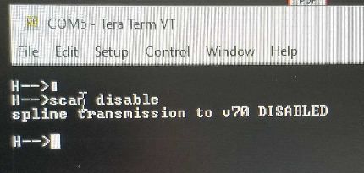
3) After any power-up or reset, perform the following initialization Commands.
3.1 In Hydra (H-->) window of TeraTerm type scan disable then Enter
USB Cable
Computer
Prog Test Board
J6 V70 UART
USB Port (Serial Com Port)
J7 HYDRA UART
USB Cable
USB Port (Serial Com Port)
51-conductor flex cable
3.2 In System (S-->) window of TeraTerm type this group:
el scale 1
el offset 0
el det 300
el scan fov 30 0 tri freq 1
el mode 4
SYSTEM PROG/TEST
Power Supply
12V 3A
+12V 0.61A
Controller Board
+
-
J4 EL DRV
J5 EL SNS
EL Motor interposer cable
Position-sensor flex cable
3.3 Hit Enter.
3.4 Verify LATM motor scans smoothly (LATM mirror should be moving without any erratic or sudden movements)
Position sensor adapter interposer circuit board

Slide 9
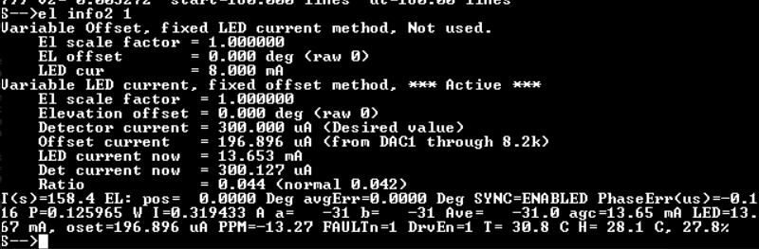
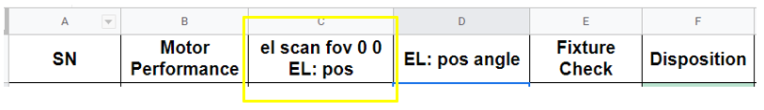
4) EL Position checking.
4.1 In System (S-->) window of TeraTerm type commands in green :
el scan fov 0 0
then Enter.
El info2 1
then Enter.
USB Cable
Computer
Prog Test Board
J6 V70 UART
USB Port (Serial Com Port)
J7 HYDRA UART
USB Cable
USB Port (Serial Com Port)
51-conductor flex cable
4.2 In System (S->) window of TeraTerm locate “EL pos” value and verify it is 0.0x degrees.
SYSTEM PROG/TEST
Power Supply
12V 3A
+12V 0.61A
Controller Board
+
-
J4 EL DRV
J5 EL SNS
EL Motor interposer cable
Position-sensor flex cable
Position sensor adapter interposer circuit board
4.3 Record the value under Scan fov 0 0 Raw Angle.

Slide 10
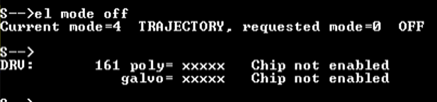
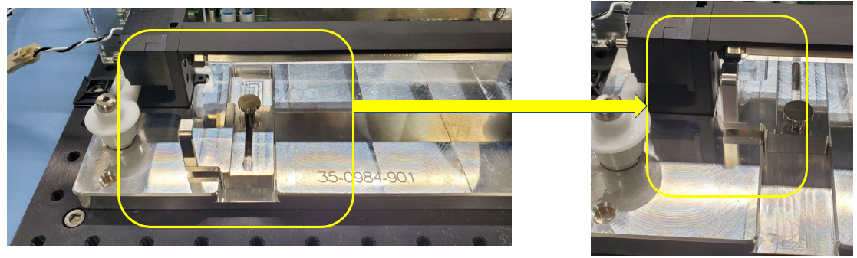
4) EL Position checking
4.4 In System (S-->) window of TeraTerm type commands in green:
el mode off
then hit Enter.
USB Cable
Computer
4.5 Verify mirror stops scanning
Example of screen when el mode off is commanded
Prog Test Board
J6 V70 UART
USB Port (Serial Com Port)
J7 HYDRA UART
USB Cable
USB Port (Serial Com Port)
51-conductor flex cable
SYSTEM PROG/TEST
Power Supply
12V 3A
+12V 0.61A
Controller Board
+
-
J4 EL DRV
J5 EL SNS
EL Motor interposer cable
Position-sensor flex cable
Position sensor adapter interposer circuit board
4.6 Place the LATM mirror at the 45-degree angle using the fixture and securing with the screw:

Slide 11
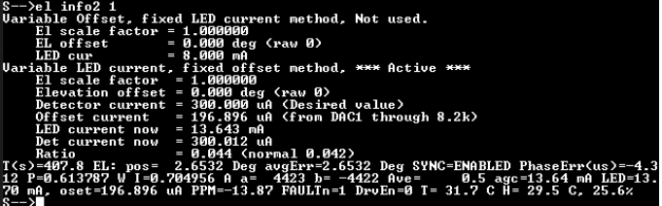
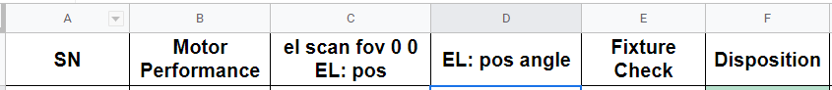
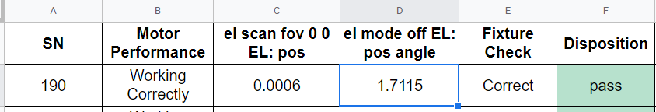
4) EL Position checking
4.7 In System (S-->) window of TeraTerm type commands in green:
El info2 1
then hit Enter.
Computer
4.8 Record the EL pos value under El mode off angle.
Prog Test Board
USB Cable
J6 V70 UART
USB Port (Serial Com Port)
J7 HYDRA UART
USB Cable
USB Port (Serial Com Port)
51-conductor flex cable
SYSTEM PROG/TEST
Power Supply
12V 3A
+12V 0.61A
Controller Board
+
-
J4 EL DRV
J5 EL SNS
EL Motor interposer cable
Position-sensor flex cable
4.9 The difference between “el scan fov 0 0 EL: pos” and “El mode off EL: pos” must not exceed +/- 4.
Position sensor adapter interposer circuit board

Slide 12
5) Turn off 12V power supply and disconnect cables
5.1 Turn off 12V power supply.
Computer
5.2 Disconnect position sense cable from interposer.
Prog Test Board
USB Cable
J6 V70 UART
USB Port (Serial Com Port)
J7 HYDRA UART
USB Cable
USB Port (Serial Com Port)
51-conductor flex cable
5.3 Disconnect EL Interposer cable from LATM assembly.
SYSTEM PROG/TEST
Power Supply
12V 3A
0V 0A
Controller Board
+
-
J4 EL DRV
J5 EL SNS
EL Motor interposer cable
Position-sensor flex cable
Position sensor adapter interposer circuit board

